Slide 1
Fundamentals of Nursing(1st Stage)
Foley catheter (practice)
Lecture 5
University of Basrah –College of Nursing – Fundamentals of Nursing Department

Slide 2
Foley catheter
A Foley catheter : is a flexible tube passed through the urethra and into the bladder to drain urine. It is the most common type of indwelling urinary catheter.
University of Basrah –College of Nursing– Fundamentals of Nursing Department
2

Slide 3
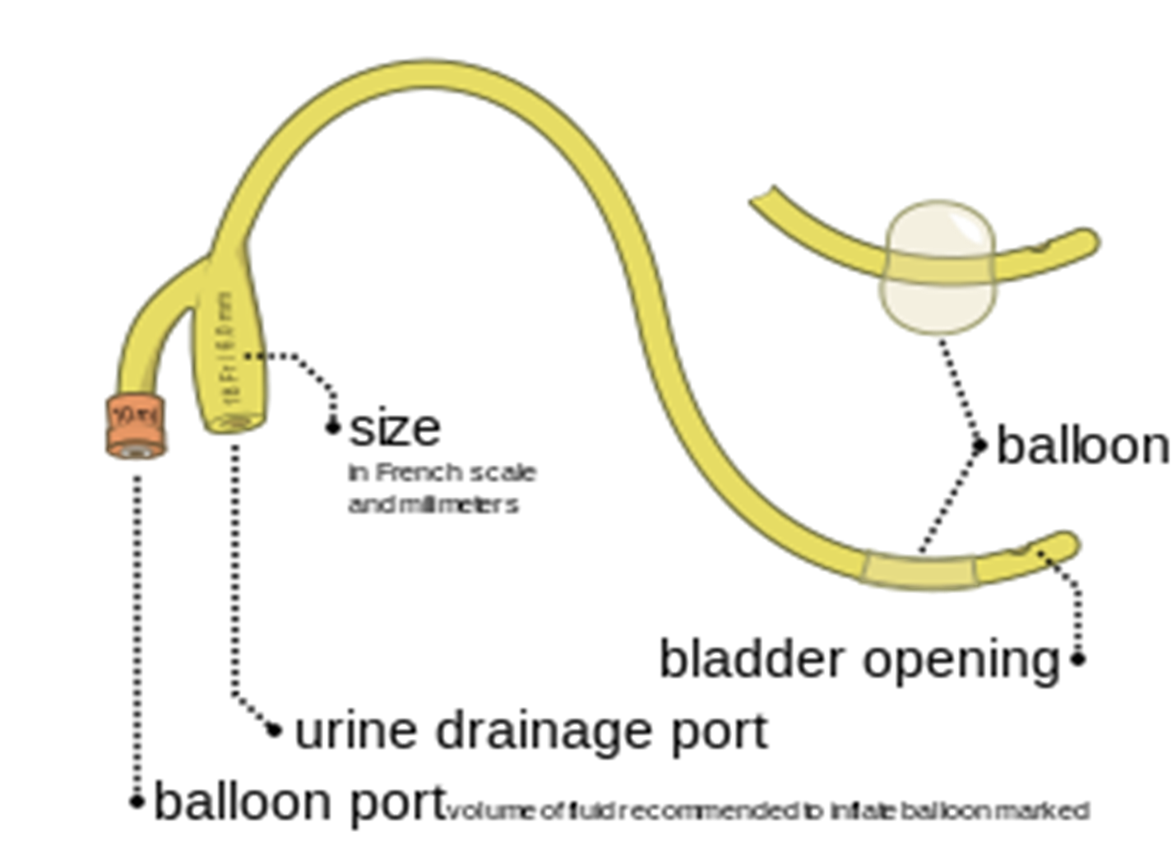

Slide 4
University of Basrah –College of Nursing– Fundamentals of Nursing Department
4

Slide 5
University of Basrah –College of Nursing– Fundamentals of Nursing Department
5

Slide 6
Medical Uses
In the urinary tract :
1. In an emergency department, indwelling urinary catheters are most commonly used to assist persons who cannot urinate.
2. Providing relief when there is urinary retention.
3.Monitoring urine output for critically ill persons.
4. Managing urination during surgery, and providing end-of-life care .
University of Basrah –College of Nursing– Fundamentals of Nursing Department
6

Slide 7
Foley catheters are used during the following situations
On patients who are anesthetized or sedated for surgery or other medical care.
On comatose patients.
On some incontinent patients.
On patients whose prostate is enlarged to the point that urine flow from the bladder is cut off. The catheter is kept in until the problem is resolved.
On patients with acute urinary retention.
University of Basrah –College of Nursing– Fundamentals of Nursing Department
7

Slide 8
On patients who are unable due to paralysis or physical injury to use either standard toilet facilities or urinals.
Following urethral surgeries.
Following ureterectomy.
On patients with kidney disease whose urine output must be constantly and accurately measured.
Before and after cesarean sections.
On patients who had genital injury.
University of Basrah –College of Nursing– Fundamentals of Nursing Department
8

Slide 9
Cervical
A Foley catheter can also be used to ripen the cervix during induction of labor.
Other
They are also used in cases of severe epistaxis(nosebleed), to block blood from freely flowing down the nasal passage into the mouth.
University of Basrah –College of Nursing– Fundamentals of Nursing Department
9

Slide 10
Contraindications
Indwelling urinary catheters should not be used in emergency departments to monitor stable people who are able to urinate or for the convenience of the patient or hospital staff.
Presence of urethral trauma.
Urethral injuries.
University of Basrah –College of Nursing– Fundamentals of Nursing Department
10

Slide 11
Adverse effects
A major problem with Foley catheters is that they tend to contribute to urinary tract infections (UTI).
University of Basrah –College of Nursing– Fundamentals of Nursing Department
11

Slide 12
There are several risks in using a Foley catheter (or catheters generally), including
The balloon can break as the healthcare provider inserts the catheter. In this case, the healthcare provider must remove all balloon fragments.
The balloon might not inflate after it is in place. In some institutions, the healthcare provider checks the balloon inflation before inserting the catheter into the urethra. If the balloon still does not inflate after placement into the bladder, it is discarded and replaced.
University of Basrah –College of Nursing– Fundamentals of Nursing Department
12

Slide 13
Urine stops flowing into the bag. The healthcare provider checks for correct positioning of the catheter and bag, or for obstruction of urine flow within the catheter tube.
Urine flow is blocked. The Foley catheter is discarded and replaced.
Catheterization introduces an infection into the bladder. The risk of bladder or urinary tract infection increases with the number of days the catheter is in place.
University of Basrah –College of Nursing– Fundamentals of Nursing Department
13

Slide 14
The urethra begins to bleed. The healthcare provider monitors the bleeding.
Catheters can be pulled out by patients while the balloon is still inflated, leading to major complications or even death. This may occur when patients are mentally impaired (e.g. they have Alzheimer's) or are in a mentally altered state (e.g. they are coming out of surgery).
University of Basrah –College of Nursing– Fundamentals of Nursing Department
14

Slide 15
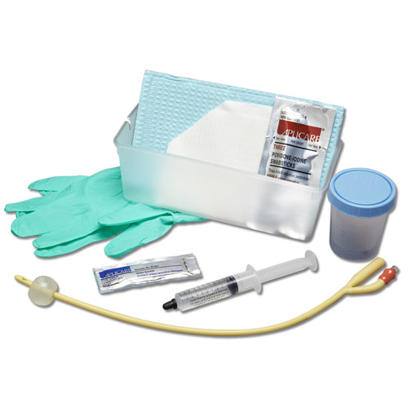
Equipment
Catheterization pack and drapes
Sterile gloves.
Appropriate size catheter .
Sterile Lubricant and/or Xylocaine jelly syringe .
Sterile normal saline
5ml/10ml Syringe – as stated on catheter packaging
Straps/tape to secure catheter to leg
Drainage bag
Waterproof sheet
University of Basrah –College of Nursing– Fundamentals of Nursing Department
15

Slide 16
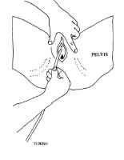
Female catheterization: The female urethra is short compared to the male urethra. It is located above the vagina in the pelvis. Insertion of the catheter is facilitated by having the patient lie down on his or her back with the buttocks at the edge of the examination table. Adequate exposure of the urethra is obtained by elevating and supporting the legs by stirrups or placing them in a frog-legged position. Finally, the labia are separated to expose the urethra.
University of Basrah –College of Nursing– Fundamentals of Nursing Department
16

Slide 17
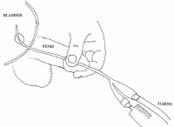
Male catheterization: The male urethra is long compared to the female urethra. A catheter is placed while lying down or in the frog-legged position. If there is a foreskin, it is retracted to its maximal limit.
University of Basrah –College of Nursing– Fundamentals of Nursing Department
17

Slide 18
Procedure
The urethra and the surrounding areas are cleaned with a cotton-ball dipped in antiseptic solution. Beginning at the urethra, the cleansing is performed in a circular motion, moving outward to the surrounding areas.
A Foley catheter, lubricated with water-soluble jelly, is inserted into the bladder through the urethra.
Once the catheter is passed, the balloon is in the bladder. It is then slowly inflated with about 10cc of water using a syringe. Inflating the balloon should not be painful.
At this time, urine, if present in the bladder, should flow back through the catheter and into the sterile drainage bag.
University of Basrah –College of Nursing– Fundamentals of Nursing Department
18

Slide 19
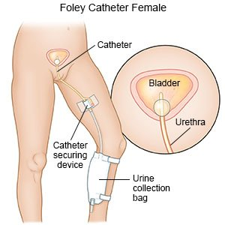
Drainage bag
While at the hospital, the urinary drainage bag will be hung to the bedside rail by a hook on the bag.
If the patient needs to be discharged from the hospital and sent home wearing the Foley catheter, the drainage bag will be replaced with a portable drainage bag (leg bag). Adhesive tape will be used to hold the bag to the calf area.
University of Basrah –College of Nursing– Fundamentals of Nursing Department
19

Slide 20
Removal of the catheter and bag
The catheter balloon is deflated by inserting a syringe into the catheter valve and pulling back on the syringe.
The pressure in the balloon will cause the water to flow into the syringe.
Once the balloon is empty, the Foley catheter can be pulled out.
University of Basrah –College of Nursing– Fundamentals of Nursing Department
20

Slide 21
Complications
Any pink or red urine or bleeding from the urethra
Symptoms do not go away
Symptoms of infection
Burning sensation upon urination
Urgency and frequency
Increased lower abdominal pain
Fever
Foul-smelling discharge coming from the urethra or in the genital area
Redness or swelling in the genital area
Pain in the urethral area or genital area
University of Basrah –College of Nursing– Fundamentals of Nursing Department
21

Slide 22
University of Basrah –College of Nursing– Fundamentals of Nursing Department
22

